Slide 1
CSE 11 Accelerated Intro to Programming Lecture 6
Greg Miranda, Summer 2 2021
This lecture is being recorded

Slide 2
Announcements
PA3 due Thursday @ 11:59pm
Lecture Quiz #3 due Friday @ 11:59pm
PA0.5 and PA1 resubmissions due Friday @ 11:59pm
PA0.5 – can also show a tutor your code running to get it checked off

Slide 3
New Point Method
Last time…
Used the Point class
Wrote simple method quadrant()
No parameters
Just used information about the point to return a String representing what quadrant it was in
Different method (for us to try…)
Write a method called add()
Take an existing Point and another Point and add their x and y values together to get a new Point
Let’s do a few steps together…

Slide 4
Method header:
What is the header for this method going to look like?
Examples:
Let’s write some examples...
Take a few minutes and try and write the body of the method

Slide 5
New Class
Try a new class, a new idea
Besides just x & y points
Another geometry example
Useful to have pictures we can draw that correspond to the class
Another idea with a coordinate plane
Want to have a class that represents lines
What are some ways we represent lines?

Slide 6
What are some methods we might want to write on a line?
One idea - like a calculator
We could provide the x value and get the y value back
A natural thing to want to compute about a line
Or about any 2D function
Examples of lines
What will this method look like?
Calculate a y value given an x value

Slide 7
Double
One of the things we had issues with integers and division
int n = 15 / 2;
We get truncation
Java, and most programming languages, have a way to use a different kind of arithmetic
double m = 15.0 / 2.0;
Does fractional arithmetic
A different type
double – floating point number

Slide 8
For most of our purposes – we can trust that doubles will be pretty accurate
We should only use doubles to represent things where we are okay with inaccuracy
The way that computers can round numbers can be surprising
double oneThird = 1.0 / 3.0;
double twoThirds = 2.0 / 3.0;
Doesn’t round off at the end
double anotherOne = (0.1 + 0.2) + 0.3;
The internal representation of these numbers isn’t perfect
Will learn all these reasons in great detail if you take CSE 30
There is some rounding happening even on simple cases
double yetAnother = 0.1 + (0.2 + 0.3);
So weird the order of parenthisation can matter

Slide 9

Will start using doubles now as another data type
Just be aware: when we use them we are expecting some kind of rounding behavior
How to mix doubles and ints?
double divided = 15 / 2;
7.5?
double dividedAgain = n / 2;
How do we get the right answer?
This is going to be important to us going forward
To be able to use doubles
Able to turn ints into calculations we can do with doubles

Slide 10
Math
Let’s look at a few ways to manipulate numbers using more built-in methods in Java
Like built-in String methods we looked at before
Square root of a number - common operation to do
double sqrt2 = Math.sqrt(2);
Takes an int or a double
double sqrt2FromDouble = Math.sqrt(2.0);
Answer is always a double
An approximation of the square root – not a full answer to the square root
Raise a number to a power
double cubeOf12 = Math.pow(12, 3);
Both methods are defined in Java’s Math library

Slide 11

More math methods
Max
double maxOf45 = Math.max(4, 5);
Min
And several other math methods as well
Two ways to think of this based on what we’ve seen before
Definition 1
Math is a built-in object
Definition 2
Math is a built-in class
sqrt, pow, max, min are a special kind of a method
Calling them with the class name before the dot
Instead of writing an object before the dot
Defn2 is the correct way to think about it
Another feature called static methods that’s coming up in future weeks

Slide 12
Memory Models
More practice with drawing diagrams for laying out objects
Build up a little more of a visual language for
Drawing objects
Drawing what’s happening inside Java
Code from the reading

Slide 13
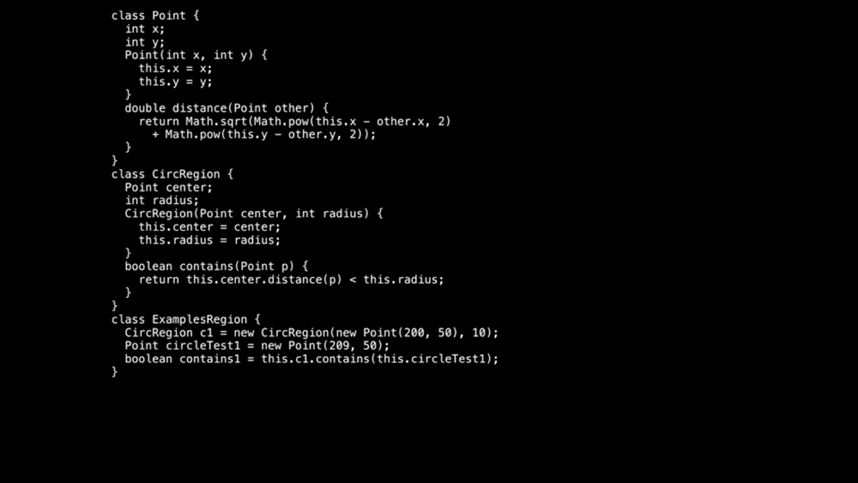

Slide 14
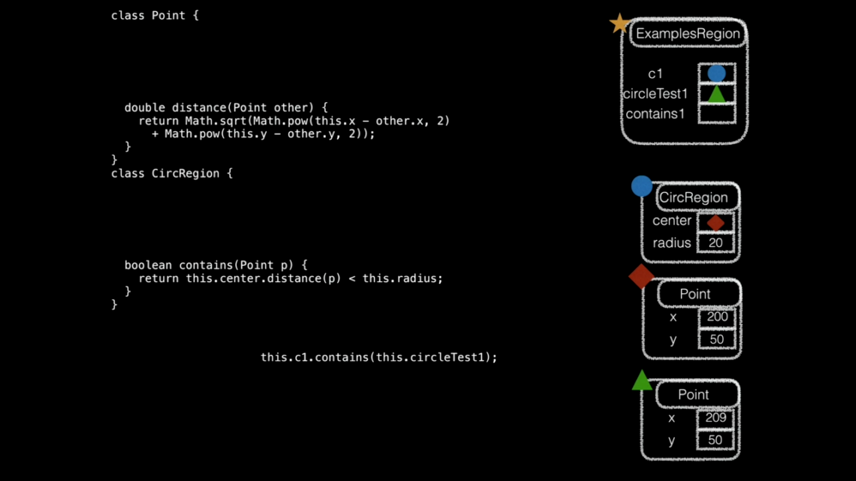

Slide 15
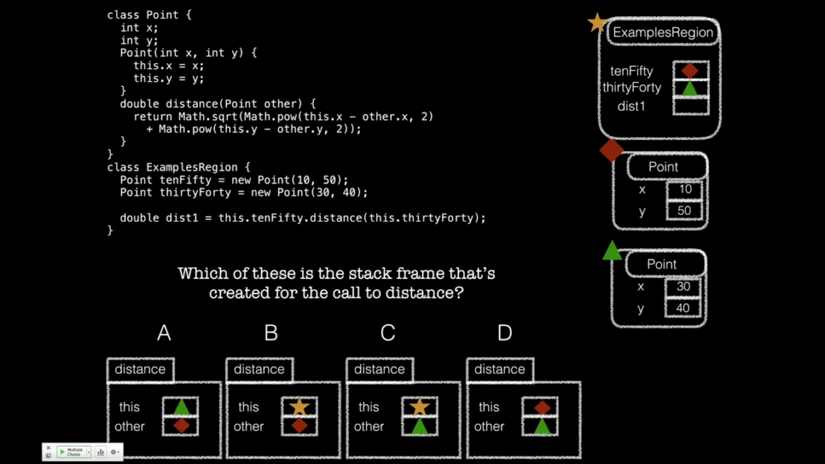






Slide 16
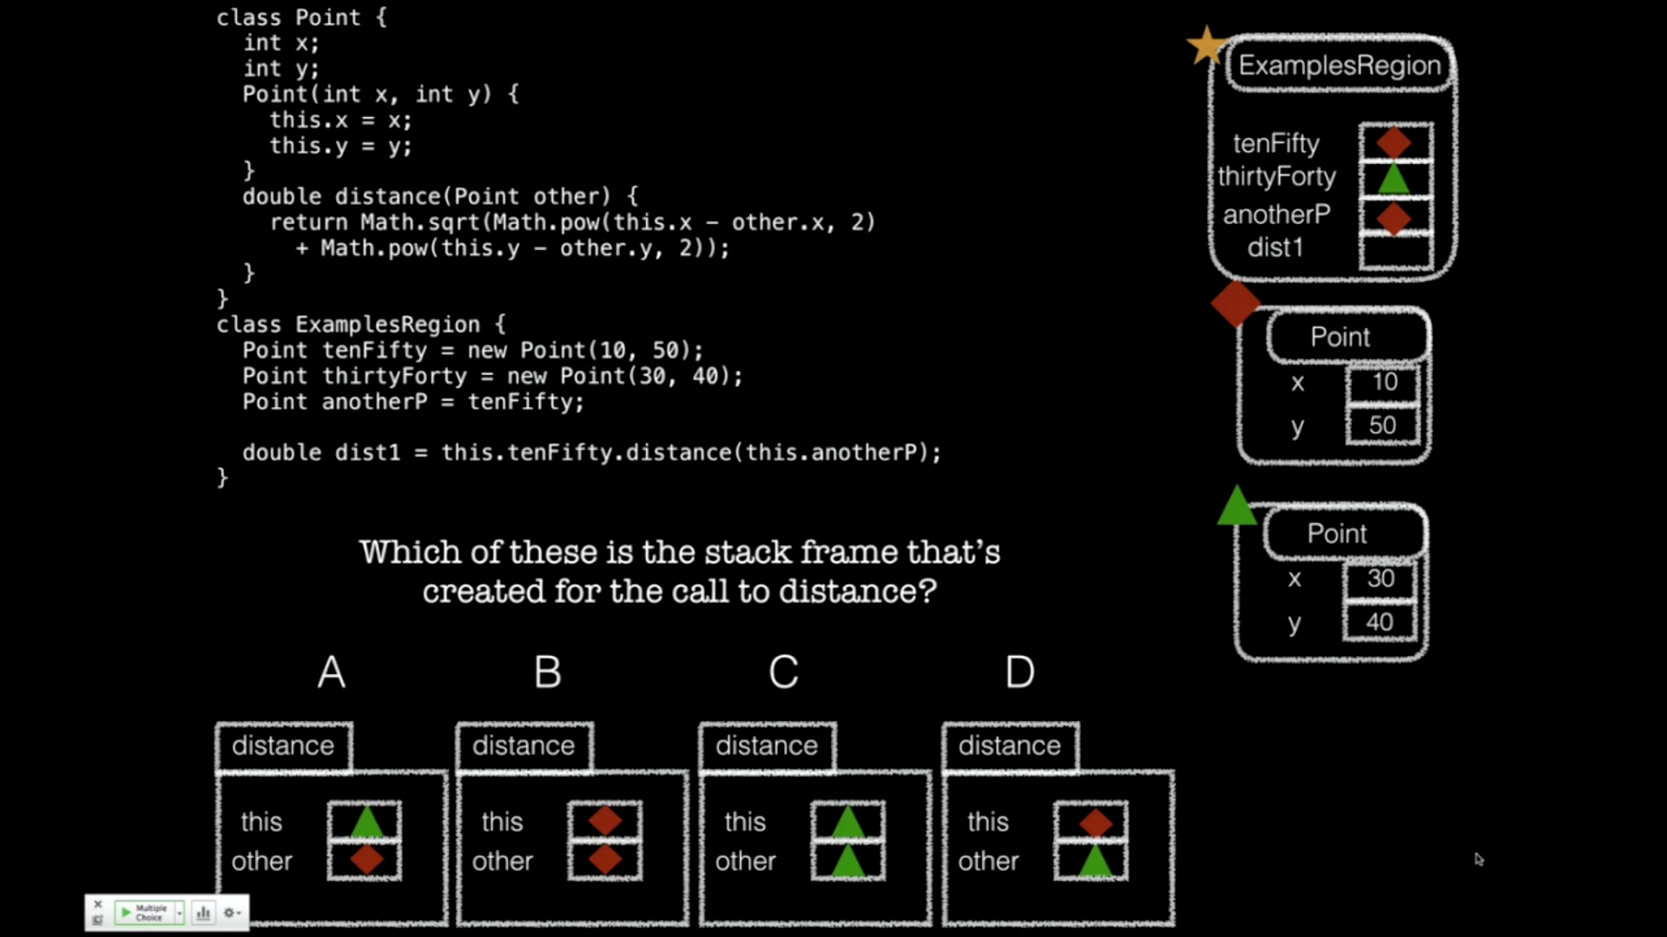




Slide 17

Constructors
Now that we understand the Stack, we have what we need to understand constructors

Slide 18
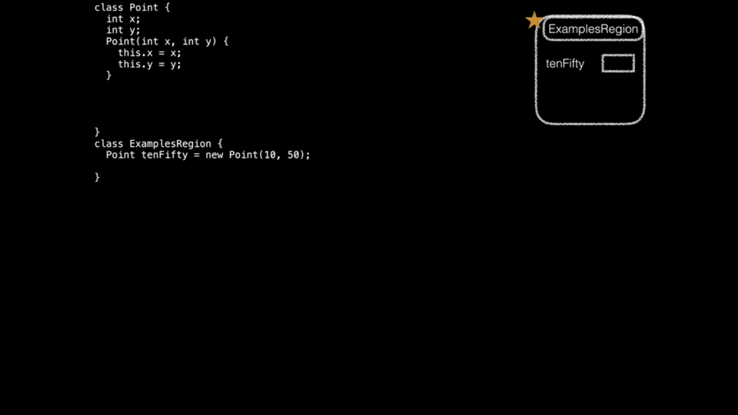

Slide 19
Constructor Summary
Constructors:
Are special methods, called when new is used
Are passed the newly-constructor object as this, and any arguments
Typically assign values into fields using this.field = value
When new is used:
A fresh object, with a new reference is created with uninitialized fields
The constructor with parameters that match the arguments is called
The whole new expression evaluates to the new reference

Slide 20
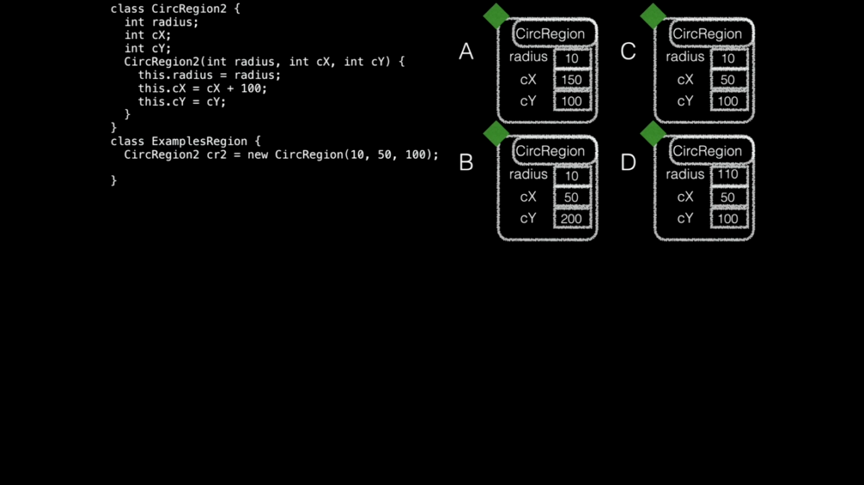


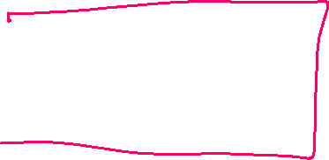

Slide 21
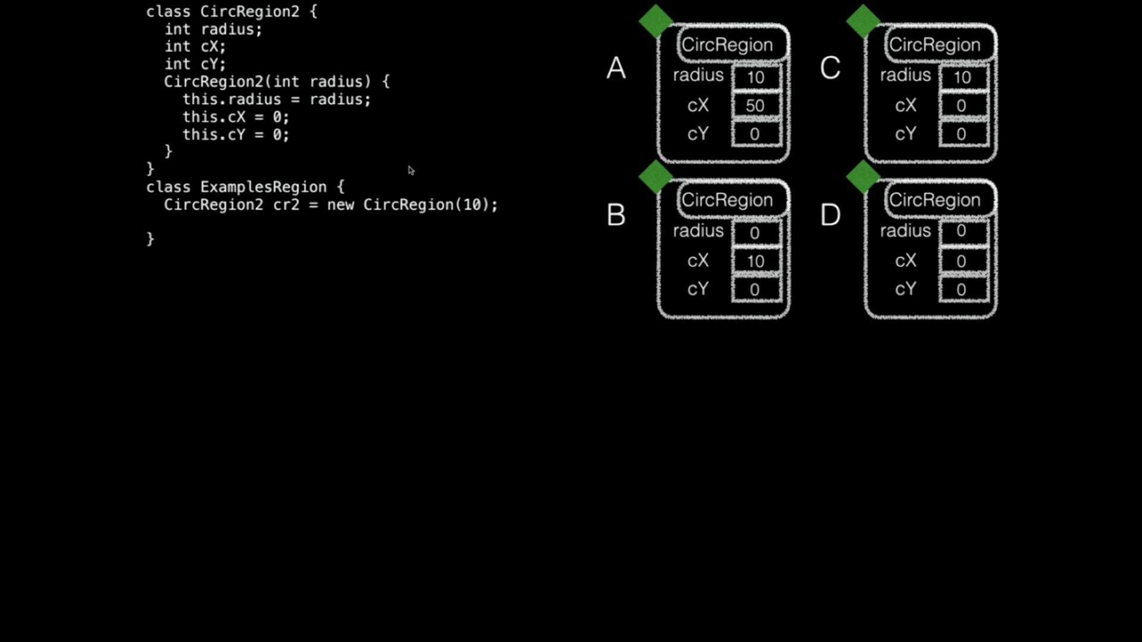


Slide 22

Tester
import tester.*;
tester.jar – java archive
Libraries that contain classes that we can use in our own code
Tester
Tester class allows us to create methods to unit test our code
Unit testing – compare actual values versus expected values
t.checkExpect(<actual value>, <expected value>);
Goal: get all tests to pass
Confidence that your code/solution is correct

Slide 23
Local Variables
Local variables are defined inside the body of a method
They are ‘local’ to the method in which they are defined in
Used temporarily while the method is running, then are removed
Similar to parameters
Added to the stack frame for the method
No default value
Must be assigned a value before it’s read from
i.e. used as an expression

